Slide 1
Next Up:
Anam Navied

Slide 2
3
3

Slide 3
2

Slide 4
1

Slide 5
PowerShell 7 Security
Anam Navied

Slide 6
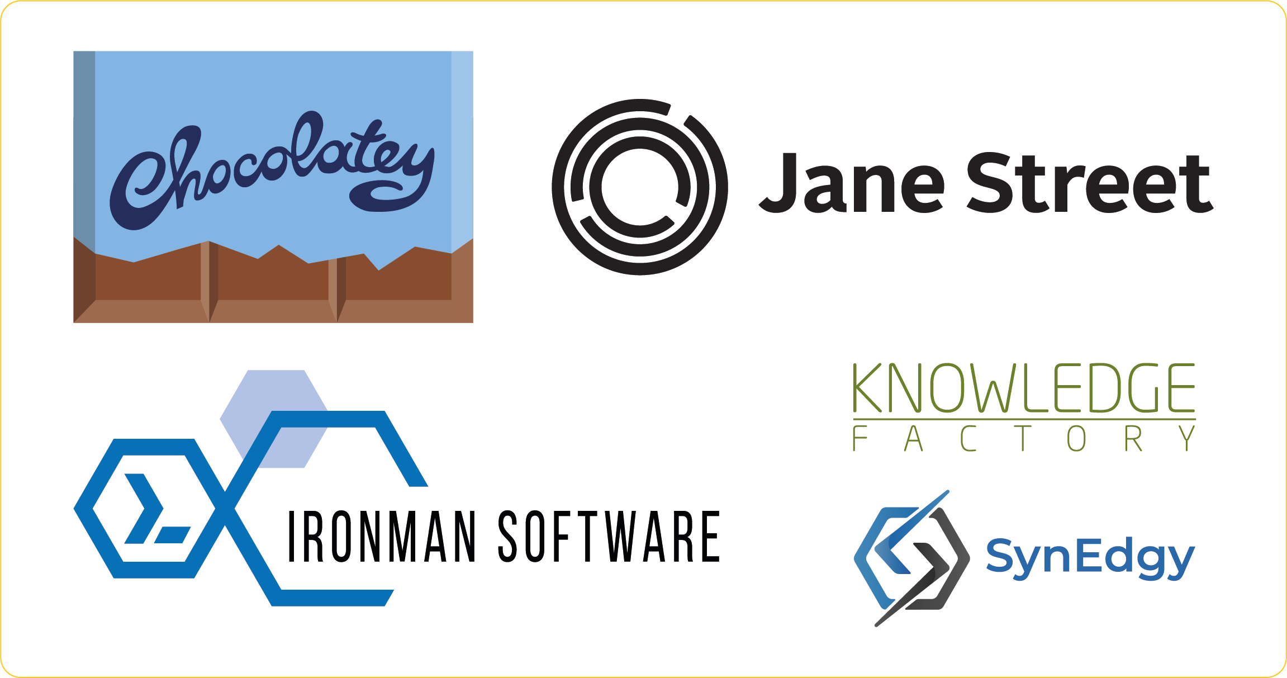
Many thanks to our sponsors:

Slide 7

Anam Navied
Software Engineer 2 on the PowerShell team
Work on Security, PSResourceGet, PSGallery
First PSConfEU!

Slide 8
Security Goals
Control which scripts, script blocks, or modules can be executed
Restrict the use of cmdlets, types, objects that can be used maliciously
Determine if a script or module is trusted by some metadata properties
Log and check errors for executed code
Know if a script payload is malicious before it is executed

Slide 9
Language Modes
Control the language elements that can be executed
ie. cmdlets, .NET types, COM/DCOM objects
Goals:
Prevent behavior that can be abused
Restrict arbitrary types

Slide 10
FullLanguage Mode
Use case:
Default mode in a session
What’s allowed ✅
Commands
Cmdlets
Scripting and scriptblocks
Defining Functions
Method invocation
.NET type access
COM type access

Slide 11
ConstrainedLanguage Mode
What’s allowed ✅
Commands
Approved cmdlets
Whitelisted functions
Basic types
What’s restricted ⚠️
Scriptblocks and scripts
.NET type access
Method invocation
New-Object
What’s blocked ❌
Custom classes
COM object access
Add-Type
Use case: Lockdown policy

Slide 12
NoLanguage Mode
What’s allowed ✅
Native commands
Native cmdlets
Use case: Extreme restriction
What’s blocked ❌
Scripts and scriptblocks
Variables
Defining functions
Method invocation
COM type access
.NET type access
New-Object (7.2+)

Slide 13
Demos

Slide 14
CLM Takeaways
ConstrainedLanguage mode is restrictive, but quite capable!
✅Native commands, approved cmdlets, core scripting features
❌Accessing unapproved types, creating PowerShell classes
Only safe types and operations are allowed
Not designed to provide full security independently

Slide 15
Application Control Policy
Lockdown experience to control which scripts and binaries are allowed to run
Only approved, trusted applications can run
Trust determined by some file metadata- ie. publisher, path, hash
Technologies for app control:
Windows Defender Application Control (WDAC) ✅
AppLocker

Slide 16
How AppControl works with PS
PowerShell session
Script typed into the shell
PowerShell runs in CLM

Slide 17
How AppControl works with PS
PowerShell session
Script typed into the shell
Script file invoked
PowerShell runs in CLM
PowerShell calls AppControl APIs

Slide 18
How AppControl works with PS
PowerShell calls AppControl APIs
System wide policy

Slide 19
How AppControl works with PS
PowerShell calls AppControl APIs
System wide policy
None
Run in FLM, as normal

Slide 20
How AppControl works with PS
PowerShell calls AppControl APIs
System wide policy
Audit
Run but log errors
None
Run in FLM, as normal

Slide 21
How AppControl works with PS
PowerShell calls AppControl APIs
Run in CLM and error
Enforce
System wide policy
Audit
Run but log errors
None
Run in FLM, as normal

Slide 22
How AppControl works with PS
PowerShell calls AppControl APIs
Run in CLM and error
Enforce
System wide policy
Individual file policy
Audit
Run but log errors
None
Run in FLM, as normal

Slide 23
How AppControl works with PS
PowerShell calls AppControl APIs
Run in CLM and error
Enforce
System wide policy
Individual file policy
Audit
Run but log errors
None
Run in FLM, as normal
None

Slide 24
How AppControl works with PS
PowerShell calls AppControl APIs
Run in CLM and error
Enforce
System wide policy
Individual file policy
Audit
Audit
Run but log errors
Run but log errors
None
Run in FLM, as normal
None

Slide 25
How AppControl works with PS
PowerShell calls AppControl APIs
Run in CLM and error
Enforce
Run in CLM and error, or block
Enforce
System wide policy
Individual file policy
Audit
Audit
Run but log errors
Run but log errors
None
Run in FLM, as normal
None

Slide 26
How AppControl works with PS
PowerShell calls AppControl APIs
Run in CLM and error
Enforce
Run in CLM and error, or block
Enforce
System wide policy
Individual file policy
Audit
Audit
Run but log errors
Run but log errors
None
Run in FLM, as normal
None

Slide 27
How AppControl works with PS
Legacy « WldpGetLockdownPolicy » API
None
Audit
Enforce
PS 7 checks new « WldpCanExecuteFile » API
« WLDP_CAN_EXECUTE_ALLOWED »
« WLDP_CAN_EXECUTE_BLOCKED »
« WLDP_CAN_EXECUTE_REQUIRE_SANDBOX »
(7.3+)

Slide 28
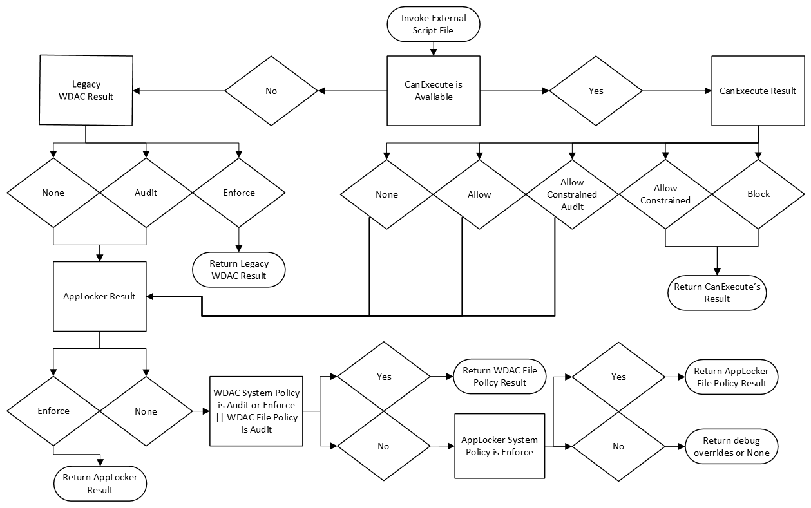

Slide 29
Language Mode boundaries
Session starts
Script typed into shell
Code runs untrusted

Slide 30
Language Mode boundaries
new scope, default to CLM
Session starts
File run = new scope
Script typed into shell
Call app control
APIs
Code runs untrusted
Code runs untrusted
Code runs trusted

Slide 31
Language Mode boundaries
new scope, default to CLM
Session starts
File run = new scope
Script typed into shell
Call app control
APIs
Code runs untrusted
Code runs untrusted
Code runs trusted
Restrictions may apply when PowerShell runs under lockdown, even if app is trusted!

Slide 32
Common Scenario #1
‘My script is signed, it’s running in FLM, so why am I getting a binding error on the script’s parameter? ’
Converting a Hashtable to object with type literals is not allowed in constrained language mode with lockdown. This could allow arbitrary or untrusted data to be passed in and used.
Solution: if you need to use a hashtable, pass that as the parameter and construct the type in your script

Slide 33
Demos

Slide 34
Common Scenario #2
‘Why am I unable to dot-source a trusted script (and its functions) into my untrusted script?’
Dot-sourcing across different language modes is blocked
Solution: Use Import-Module to explicitly export functions. If you must dot-source, ensure all your scripts run at the same trust level

Slide 35
Demos

Slide 36
Common Scenario #3
‘I’m importing a trusted module that dot-sources a script and exports functions with wildcard (Export-ModuleMember –Function ‘*’), why do I get an error?’
Using the dot-source operator in modules that export functions by wildcard is not allowed. This could inadvertently expose functions
Solution: Always export module functions explicitly by name

Slide 37
Demos

Slide 38
Common Scenario #4
‘My module has a .psm1 with some functions, and a .psd1 which exports some functions. Is there anything else I should do to prevent my functions from being unintentionally exposed?’
Even if the .psd1 specifies which functions to export, someone can try to directly import the .psm1, so good practice to add a filter there as well.
Solution: Add a filter in the .psm1 to filter which functions are allowed to be exported at the .psm1 module level

Slide 39
Demos

Slide 40
Restrictions under AppControl policy
ConstrainedLanguage restrictions when the app is untrusted or sandboxed:
PowerShell module script files (.psm1) and manifest file (.psd1) must explicitly export functions by name without wildcards
Type conversion to unapproved types is not allowed
COM objects cannot be created
Approved .NET types only
Add-Type cmdlet is blocked
Use of PowerShell classes are not allowed
PowerShell type conversion is not allowed
Dot sourcing across language modes is not allowed
Command resolution will make certain commands unavailable
Invoke-Expression will run in CLM

Slide 41
PowerShell 7 versus 5
PowerShell 7 -> newer robust features, improved logging whereas WinPS patches focus on security fixes
7.4+ -> supports AppControl policies in Audit mode and improved logging
7.3+ -> supports new WDAC API to block or restrict unapproved files
7.3+ -> extends AMSI support to all .NET method calls
7.2+ -> disallows COM objects in lockdown

Slide 42
Key Takeaways
ConstrainedLanguage (CLM) is designed to be used with system lockdown control
In CLM, use approved .NET types, avoid dot sourcing, export functions explicitly, avoid dynamic code execution, etc
Restrictions may apply under lockdown policy if your code cross language mode boundaries
Refer to the docs and blogposts for security best practices, updates and more

Slide 43
Q&A
15 minutes

